Slide 1
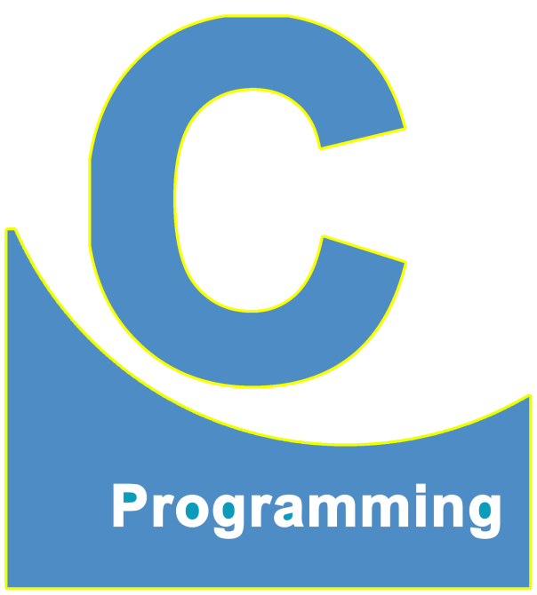
01
02
C Language
Lecture 13
04

Slide 2


Today’s Agenda
01
Important Points About Div and Mod Div
02
Relational Operators

Slide 3
Important Points About Div and Mod Div
If we divide a smaller value with a greater value and both are INTEGERS then
the resultant answer will always be 0
For Example :
1/2 -------------→ 0
7/10 -----------→ 0
4/20 -----------→ 0
8/9 -------------→ 0

Slide 4
Important Points About Div and Mod Div
If we perform mod of INTEGER VALUE and numerator is smaller that
denominator , then answer will always be numerator itself
For Example :
1%2 -------------→ 1
7%10 -----------→ 7
4%20 -----------→ 4
8%9 -------------→ 8

Slide 5
Important Points About Div and Mod Div
Another important point to remember about % (modulo div) is that this
operator ONLY WORKS WITH INT VALUES AND NOT FLOAT VALUE
For Example :
2.0%1.0---------→ ERROR
2%1.0 -----------→ ERROR
2.0%1------------→ ERROR

Slide 6

Important Points About Div and Mod Div
Will the following compile ?
#include <stdio.h>
#include <conio.h>
void main()
{
char ch1=‘A’;
char ch2=‘B’;
int x,y;
x=ch1%ch2;
y=ch2%ch1;
printf(“%d %d”,x,y);
getch();
}
OUTPUT :
65 1

Slide 7
Important Points About Div and Mod Div
Yet another point to remember about mod is that the sign of the answer
(remainder) is always same as the sign of the numerator.
Thus if the numerator is positive, the sign of the remainder will also be positive
AND If the numerator is negative then sign of the remainder will also be
negative.
So
7%5 -------------→ 2 -7%5 -------------→ -2
7%-5 ------------→ 2 -7%-5 -------------→

Slide 8
Important Points About Div and Mod Div
How do we calculate power (exponent) in C language ?
Many beginners in C language think that C has a separate operator for calculating
power which is ABSOLUTELEY WRONG.
So
3 ^ 4
3 ** 4
3 $ 4
This is because C has no special operator for calculating power.
They all are wrong !!

Slide 9
The float Data Type
But to calculate power in C language, we have 2 solution :
a.
int x;
x=3*3*3*3;
printf(“%d”,x);
For using pow() function, we will have to include the header file called as “math.h”
b.
int x;
x=pow(3,4);
printf(“%d”,x);

Slide 10
The float Data Type
In C, mathematical capabilities
Operator
Function
+
-
*
/
%
pow()
sqrl()
log()
sin()
cos() etc….

Slide 11
Relational Operators
These are overall 6 relational operators :
1. > (Greater than)
2. < (Less than)
>= (Greater than or equal to)
4. <= (Less than or equal to)
== (Equals to)
!= (Not equal to)

Slide 12
Relational Operators
= | ==
Assignment Operator | Equality Testing Operator
int a=10, b=7; a=b; This will copy/assign the value of variable b to the variable a. Printf(“%d %d”,a,b); 7 7 | int a=10, b=7,c; c = a==b; Equality Comparison
Equal
Not Equal
True
False
1
0
c = 0

Slide 13
Relational Operators
Relational Operator
>
<
>=
<=
!=
==
True
1
Condition Check
False
0

Slide 14
Relational Operators
Guess the output ?
int a=10, b=7, c;
c=a=b;
printf(“%d %d %d”,a, b, c);
Such expression are called as Multi-Assignment Expression. They are read from
Left to Right but they are solved from Right to Left.
OUTPUT : 7 7 7

Slide 15
Relational Operators
Suppose we want to assign same value in 5 variables.
For example, we have 5 variable called a, b, c, d, e and we want to
assign 10 in all of them.
int a,b,c,d,e;
a=10;
b=10;
c=10;
d=10;
e=10;
int a,b,c,d,e;
a=b=c=d=e=10;
Multi-Assignment Expression

Slide 16
Relational Operators
Guess the output ?
int a,b,c,d,e;
a=b=c=d=e;
printf(“%d %d %d %d %d”,a,b,c,d,e);
Although the code will compile and run, but we will get GARBAGE value
as output.
This is because we have initialized all the variables with the value of variable
e and e itself is initialized with some garbage.

Slide 17
Relational Operators
Guess the output ?
int a,b,c,d,e;
a=b=c=d=10=e;
printf(“%d %d %d %d %d”,a,b,c,d,e);
SYNTAX ERROR : The code won’t even compile !!
Assignment operator in C language has an important restriction
The LHS of assignment operator MUST ALWAYS BE A VARIABLE and NOTHING ELSE

Slide 18


Relational Operators
Guess the output of all of them ?
int a=10, b=10,c;
c=a=b;
2. c=a==b;
3. c=a=‘b’;
4. c=a==‘b’;
5. c=‘a’==b;
6. c=‘a’=‘b’;
7. c=‘a’= b;

Slide 19
Variable v/s Character
b | ‘b’
Variable | Character constant
Value depends on programmer | Value will be 98

Slide 20
Assignment v/s Not Equal To
== v/s !=
1. == and != are OPPOSITES of each other
2. That is, whenever == will give true i.e. 1, at the same place
!= will give us false i.e. 0 and vice versa.

Slide 21
Assignment v/s Not Equal To
Example :
int a=10,b=10,c,d;
c=a==b;
c=10==10; ------→ True----→1
d=a!=b;
d=10!=10; ------→ False ---→0
printf(“%d %d %d %d”,a,b,c,d);
OUTPUT : 10 10 1 0

Slide 22
Assignment v/s Not Equal To
Example :
int a=10,b=7,c,d;
c=a==b;
c=10==7; ------→ False---→0
d=a!=b;
d=10!=7; ------→ True ---→1
printf(“%d %d %d %d”,a,b,c,d);
OUTPUT : 10 7 0 1

Slide 23

End of Lecture 13
For any queries mail us @: scalive4u@gmail.com
Call us @ : 0755-4271659, 7879165533
Thank you

